Slide 1

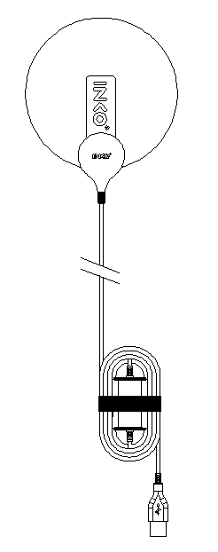




Product brief
SU0108A2
SPSGU5NNNN
Product Description
5V,5W heating pad
Fabric(Suede)
Printed PET film heater
3 step LED controller
Features and Benefits
Uniformity
Thin thickness
Flexibility
Key Applications
Heating pad
Warmer

Slide 2
Product Data Sheet
SU0108A2/ SPSGU5NNNN
Table of Contents
Index | page
Product Brief | 1
Table of Contents | 2
Performance Characteristics | 3
Characteristic Diagram | 4
Reliability Test | 5
Mechanical Dimensions | 6
Product Nomenclature | 7
Packaging | 8
Precaution For Use | 9

Slide 3
Product Data Sheet
SU0108A2/ SPSGU5NNNN
Performance Characteristic
Category | standard | Tolerance | Remarks
product name | SU0108A2
P/N | SPSGU5NNNN
Fabric | Suede, 0.7t | ±0.3mm
Size | Mat: 110Ø X 1.5mm Controller: 25mm X 35mm X 10mm | ±2mm
Weight | Mat: 10g Controller: 36g | ±10%
Rated voltage | 5 DCV | -
Resistance | 5Ω | ±10%
Electricity | 5W | ±10%
Power density | 0.47W/cm2 | ±10%
Temperature of use | LEVEL : 1 (40℃) 2 (47℃) 3 (55℃) |  | Sensor control
Operating condition 1 | MAX. 90min |  | off
Operating condition 2 | Insulation thermal 70℃ |  | off
* Resistance is a measurement tolerance
* Temperature of use is single product operating environment
* After turn on the power button, power on and set to level 3 automatically
Absolute Maximum Rating
 | Voltage used | Heater temperature | Operating conditions
Single Product Operating Environment | ~ 7V | 80℃ | at 25℃
* Product is not guaranteed for operations above the above conditions

Slide 4
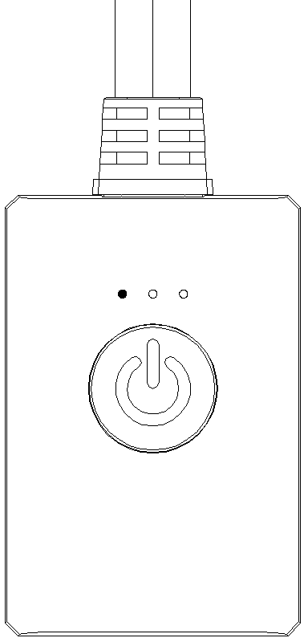
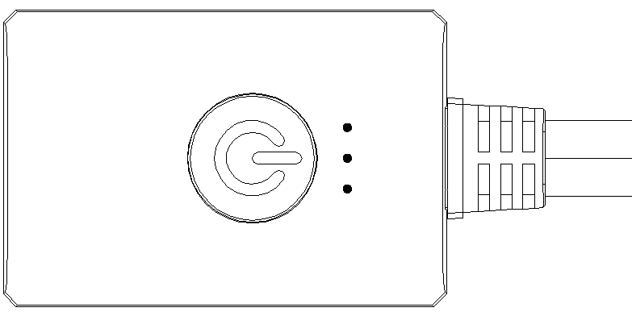





Product Data Sheet
SU0108A2/ SPSGU5NNNN
Characteristic Diagram
Test method : 25℃, 1 Measurement of saturation temperature at voltage rise
LEVEL1
LEVEL2
LEVEL3
ON
40℃
ON
47℃
ON
55℃

Slide 5
Product Data Sheet
SU0108A2/ SPSGU5NNNN
Reliability Test
※ Judgement is change before and after
Item | Test Condition | Unit | Number of Damage | Judgment | Result
Folded test | Folded, 1 cm in diameter, 80 kg Press repeatedly and measure current, resistance check | 4,500 Cycle | 0/3 | <±8% | OK
Twist test | 180° twist , resistance check (End to end :1kg force) | 15,000 Cycle | 0/3 | <±8% | OK
Press hard test | 10 cm in diameter, 80 kgf, resistance check | 60,000 cycle | 0/3 | <±8% | OK
continuous operating | Rated 5V, resistance check | 2,000 Hours | 0/3 | <±8% | OK

Slide 6
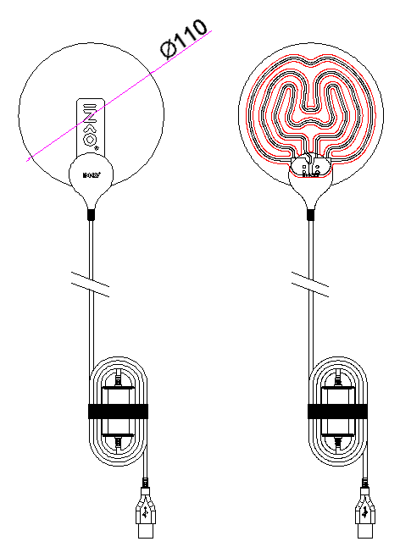
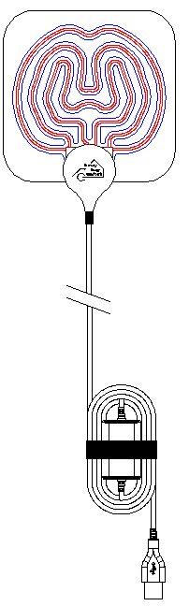
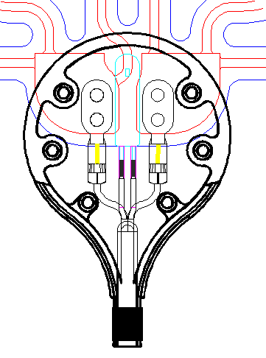
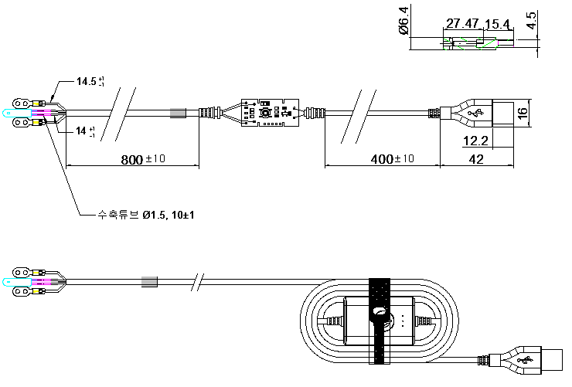
Product Data Sheet
SU0108A2/ SPSGU5NNNN
Mechanical Dimensions
Notes : All dimensions are in mm

Slide 7
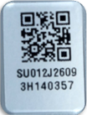
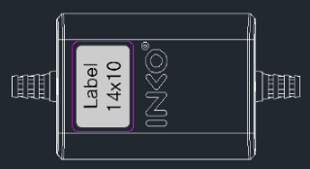
Product Data Sheet
SU0108A2/ SPSGU5NNNN
Product Nomenclature
For quality and LOT tracking
Management, attach QR barcode
Stickers to the back of the controller.
① Part Numbering System
P₁P₂P₃P₄P₅P₆P₇P₈P₉P₁₀
SPSGU5NNNN
P1 | P2 | P3 | P4 | P5 | P6 | P7 | P8 | P9 | P10
Series | product | Material | Color | Power type | W | the closing part | Thermoelectronic Film | Remote | Labels
S-Soft On | P - USB Play | S- Suede | R-Rosewood | U-USB | 5 | N-Normal (Gray) | N-Normal (Black) | N-Normal (Gray) | N-Normal
 | H - portable heating cushion | T- TPU | B-Blue | D1-DC 12V | 7 | CC-Customized Color | C-Customized color & logo | NL-Normal LOGO (INKO) | CC-Customized Color
 | J - Thermal heater | M- Micro Hiber | G-gray | D2-DC 24V | 9 | CL-Customized Logo |  | CC-Customized Color | CL-Customized Logo
 | JN - Slim Fit Thermal heater | P-Poly ester | BE-beige |  | 37 |  |  | CLO-Customized Logo | C-Color & Logo both
 | PJ- Pocket-type thermal Heater |  | N-Navy |  | 60 |  |  | CLI-Customized Line (Change color/length)
 | S- sleep+ a portable heating mat |  | FG-Forest Green
 | B- NEW premium microfiber heating blanket |  | Y-Yellow
 | U- slim Detachable USB Hot pack |  | BR-Amber Brown
 | C- Memory foam heating cushion |  | SP-Soft pink
② Serial Numbering System
Model Information |  |  |  |  | Manufacturing Information(LOT Number) |  |  |  |  |  |  | Assembly Date |  |  |  |  | Serial number
Material | Marking | Company /APP | Marking |  | Year of production | Marking | Month | Marking | Date | LOT order |  | Year of production | Marking | Month | Marking |  | Sequence
PET | FE | client 1 | 00 |  | 2023 | 3 | 1 | A | 00 | 00 |  | 2023 | 3 | 1 | A |  | 0000
PI | FI | client 2 | 01 |  | 2024 | 4 | 2 | B | 01 | 01 |  | 2024 | 4 | 2 | B |  | 0001
SUS | US | client 3 | 05 |  | 2025 | 5 | 3 | C | 02 | 02 |  | 2025 | 5 | 3 | C |  | 0002
Al | UA | client 4 | 02 |  | 2026 | 6 | 4 | D | 03 | 03 |  | 2026 | 6 | 4 | D |  | 0003
USB | SU | client 5 | 03 |  | 2027 | 7 | 5 | E | 04 | 04 |  | 2027 | 7 | 5 | E |  | 0004
adaptor | SD | client 6 | 04 |  | 2028 | 8 | 6 | F | 05 | 05 |  | 2028 | 8 | 6 | F |  | 0005
 |  | . | . |  |  |  | 7 | G | 06 | 06 |  |  |  | 7 | G |  | 0006
 |  | . | . |  |  |  | 8 | H | 07 | 07 |  |  |  | 8 | H |  | 0007
 |  | . | . |  |  |  | 9 | I | 08 | 08 |  |  |  | 9 | I |  | 0008
 |  |  |  |  |  |  | 10 | J | 09 | 09 |  |  |  | 10 | J |  | 0009
 |  |  |  |  |  |  | 11 | K | ~ | ~ |  |  |  | 11 | K |  | ~
 |  |  |  |  |  |  | 12 | L | 31 | 99 |  |  |  | 12 | L |  | 9999

Slide 8
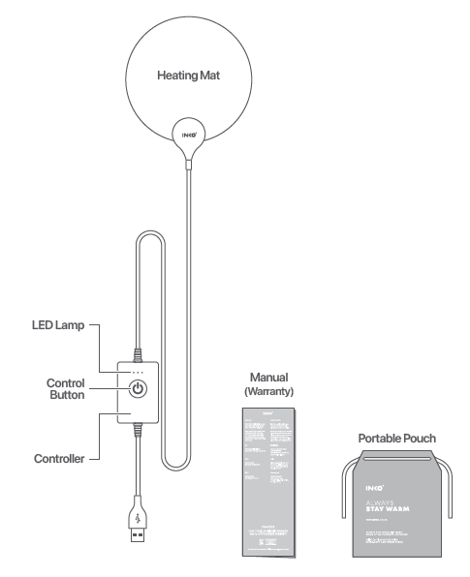
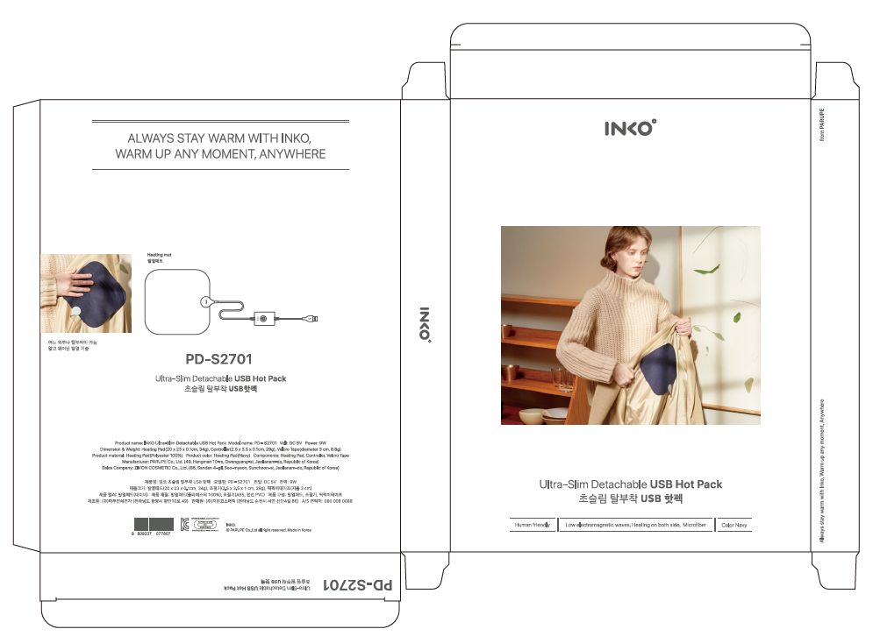
Product Data Sheet
SU0108A2/ SPSGU5NNNN
Packaging
Packing Box
Components
Packing Box

Slide 9
Product Data Sheet
SU0108A2/ SPSGU5NNNN
Precaution for Use
Use carefully to avoid the risk of low-temperature burns if used for a long time.
Do not touch with a heat-generating product.
(Do not use for infants and toddlers under 3 years old.)
Do not use this device on the elderly who are sensitive to heat or cannot cope with
overheating.
If you have sensitive skin, it is recommended to use after a test or consultation.
If the product is damaged or broken, do not plug it in and contact the customer
service center.
Do not damage or arbitrarily disassemble, repair, or modify with sharp instruments
Keep the product away from fire.
Avoid wet areas when using or storing, and do not connect to power, especially with
wet hands.
Do not fold or crumple severely when using or storing.

Slide 10
HEAD OFFICE
10, Sandan 4-gil, Seo-myeon, Suncheon-si, Jeollanam-do, Republic of Korea,(57927)
FACTORY
49, Hangman 10-ro, Gwangyang-si, Jeollanam-do, Republic of Korea(57793)
SEOUL OFFICE
PARU B/D 71, Mokdongjungangbuk-ro, Yangcheon-gu, Seoul Korea(07947)
TEL +82-61-755-5114
FAX +82-61-753-0134

